Slide 1

Random forest classficaiton
Hussein Hijazi
Farshad Moradi Shahrbabak

Slide 2
What is random forest :
Random forest is a supervised learning algorithm
classification problems
regression problems
It is one of the most flexible and easy to use algorithm. It creates decision trees on the given data samples, gets prediction from each tree and selects the best solution by means of voting

Slide 3
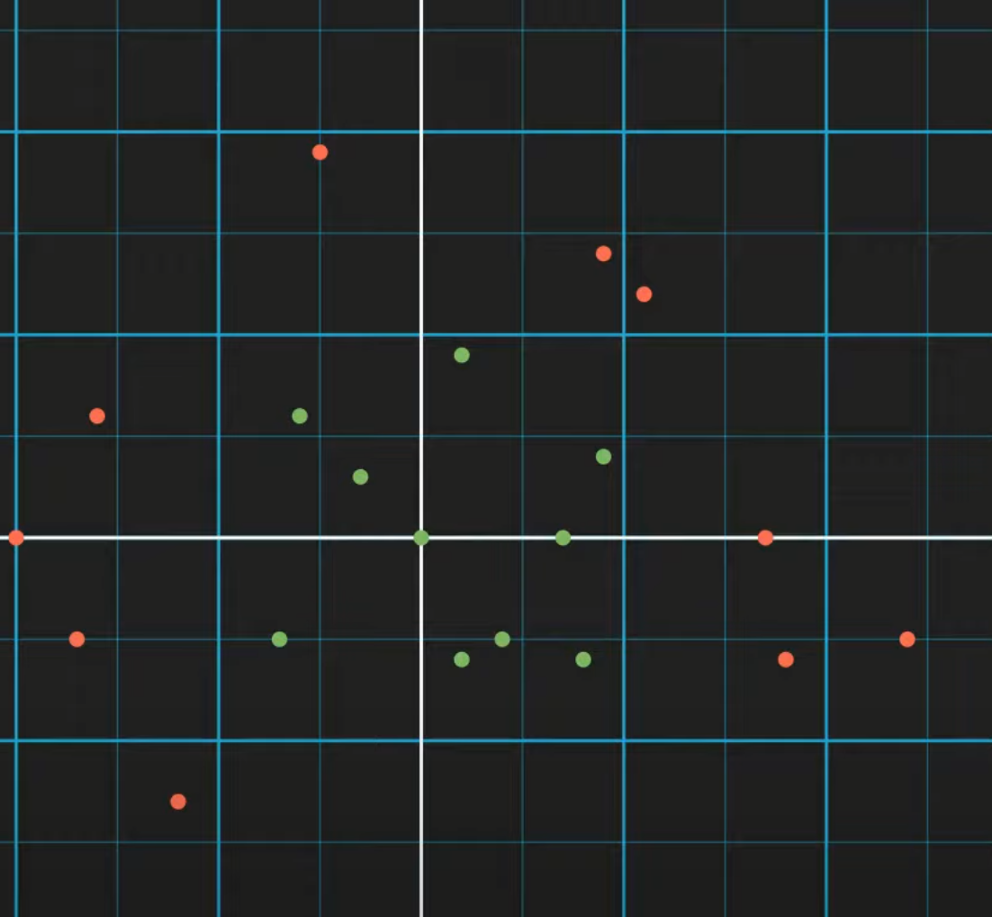
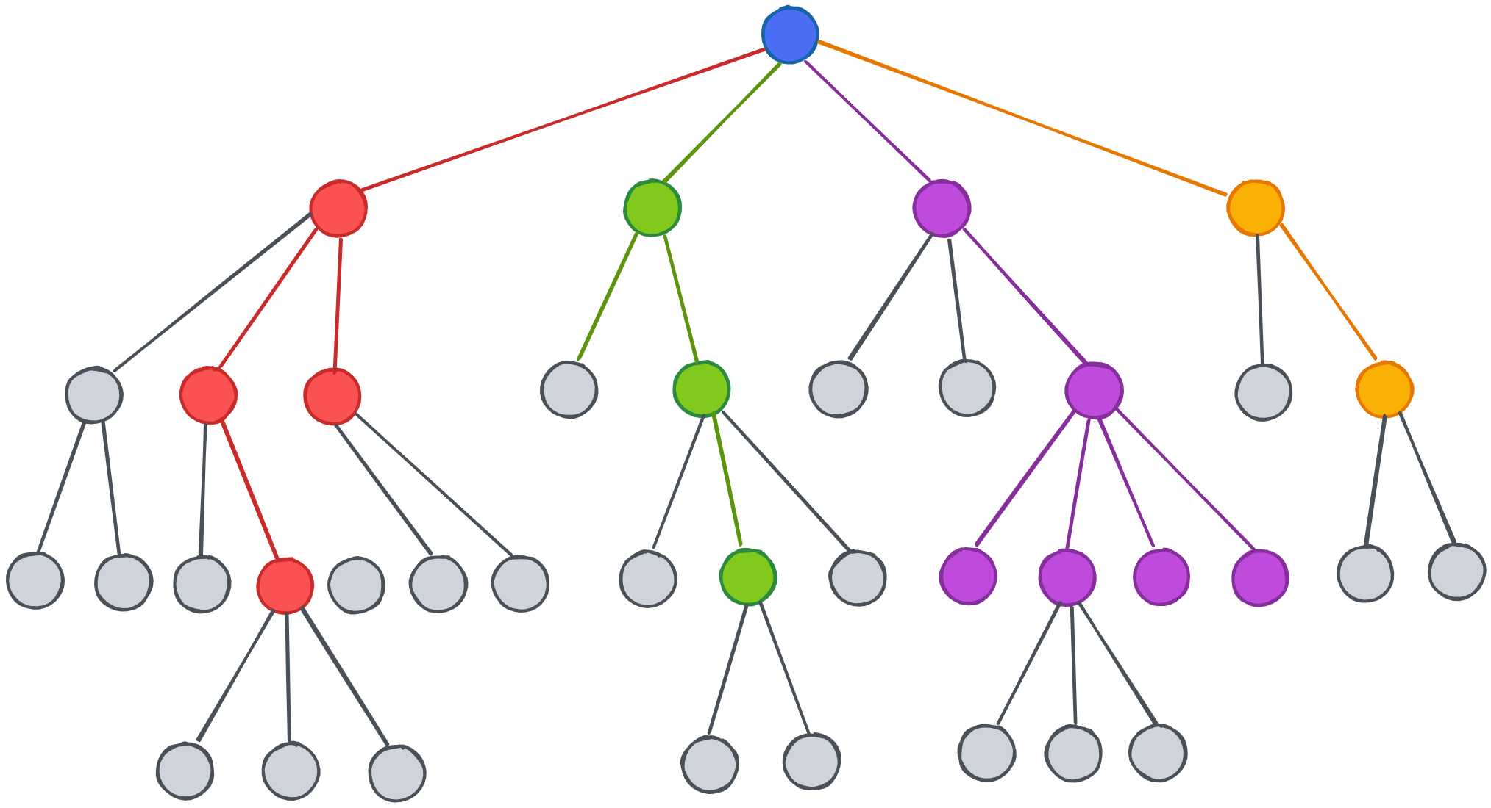
Decision trees
A decision tree is a flowchart-like tree structure where an internal node represents a feature(or attribute), the branch represents a decision rule, and each leaf node represents the outcome.
Decision trees are popular due to their simplicity and the fact that they can be visualized, which makes them easy to understand. However, they can be prone to overfitting, especially with very complex trees

Slide 4
Why Random forset instead of decision tree?
Random Forest:
Less sensitive to training data.
Utilizes bootstrapping for stability.
Enhanced generalization capability compared to decision trees.
Decision tree :
Highly sensitive to training data
Prone to changing significantly with dataset variations
Difficulty in generalizing due to sensitivity

Slide 5
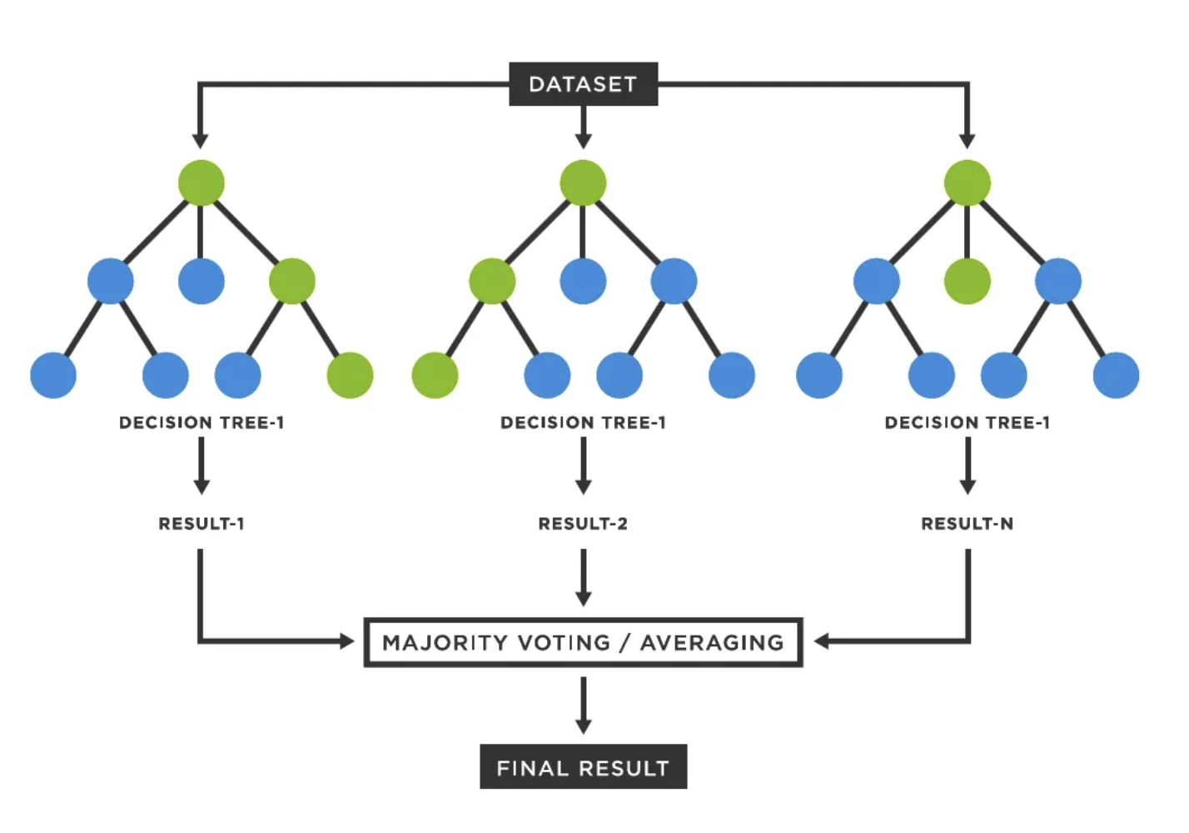
How random forest works
Bootstrap Aggregating (Bagging): Random Forest begins by creating multiple subsets from the original dataset, with replacement, known as bootstrap aggregating, or bagging. Each subset is used to train a separate decision tree.
Feature Randomness: When building each tree, Random Forest introduces additional randomness. At each split, it selects a random subset of features, rather than considering all features. This ensures that the trees are diverse and reduces correlation among them.
Building Trees: Each tree is grown to the largest extent possible without pruning, leading to fully grown, deep trees.
Aggregation for Decision Making: For classification tasks, the mode of all the predictions from different trees is taken as the final prediction. For regression, the average prediction is considered.

Slide 6
Advantages
Versatility: Random Forest tackles both classification and regression tasks effectively.
Accuracy: Its robustness, stemming from a multitude of decision trees, ensures high prediction accuracy.
Bias Reduction: By averaging predictions, it mitigates biases and guards against overfitting.
Handling Missing Values: Offers robust mechanisms to manage missing data, enhancing data pre-processing capabilities.
Feature Selection: Enables the identification of crucial features, streamlining model building and interpretation.

Slide 7
Disadvantages
Computational Complexity: Its reliance on numerous decision trees leads to slower prediction times, increasing computational demands.
Interpretability: Random Forest models are less intuitive to interpret compared to single decision trees, making it challenging to grasp feature contributions.

Slide 8

Problem definition
The objective of this project is to develop a car evaluation system using machine learning techniques. The goal is to classify cars into four acceptability classes: "unacc" (unacceptable), "acc" (acceptable), "good," and "vgood" (very good) based on input attributes such as buying price, maintenance cost, number of doors, capacity, luggage boot size, and safety rating. This system will aid in decision-making processes for car buyers and manufacturers by providing accurate evaluations of car acceptability.

Slide 9

Car Evaluation Data Set

Slide 10
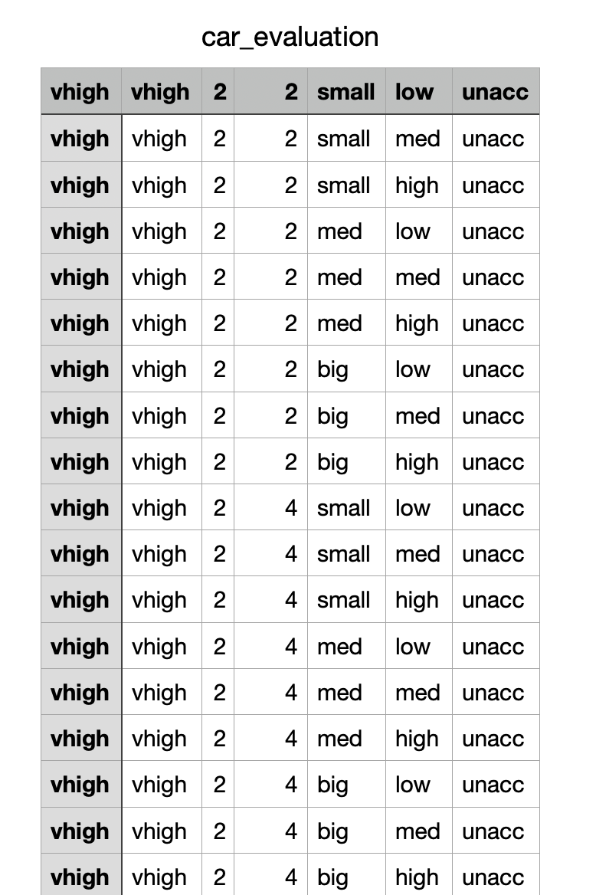
Car Evaluation Data Set
Class Values:
The target variable with four class values: "unacc" (unacceptable), "acc" (acceptable), "good," and "vgood" (very good), representing overall car acceptability.
Buying:
Categorizes the buying price into four levels: "vhigh" (very high), "high," "med" (medium), and "low."
Maintenance (Maint):
Categorizes the maintenance cost into four levels: "vhigh" (very high), "high," "med" (medium), and "low."
Doors:
Indicates the number of doors in the car, with options ranging from 2 to "5more."
Persons:
Represents the seating capacity, categorized into three levels: 2, 4, and "more."
Luggage Boot (Lug_boot):
Describes the size of the luggage boot or trunk space, categorized as "small," "med" (medium), and "big."
Safety:
Indicates the estimated safety level, categorized as "low," "med" (medium), and "high."
Car Evalution dataset

Slide 11
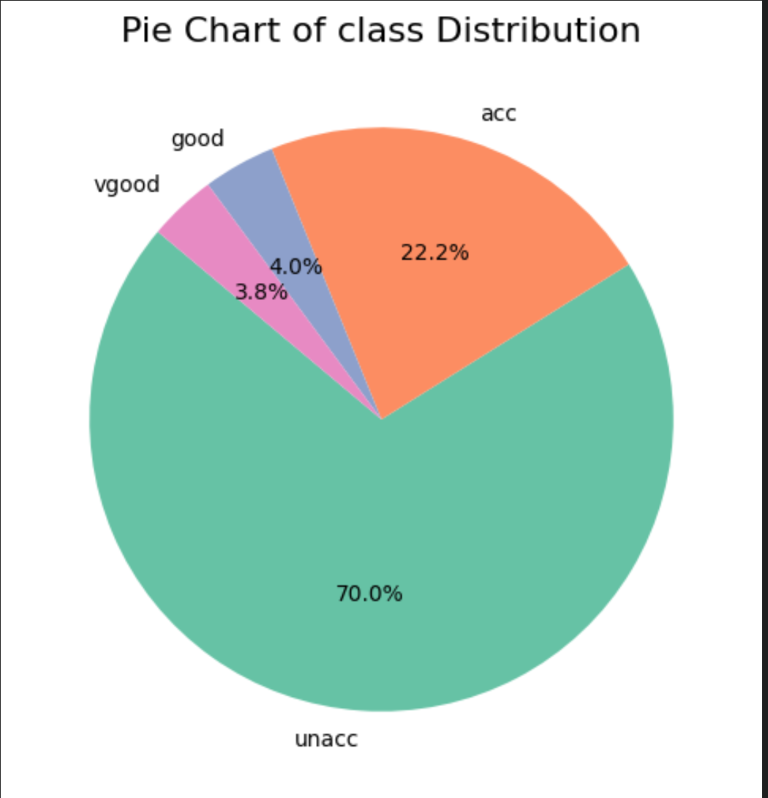
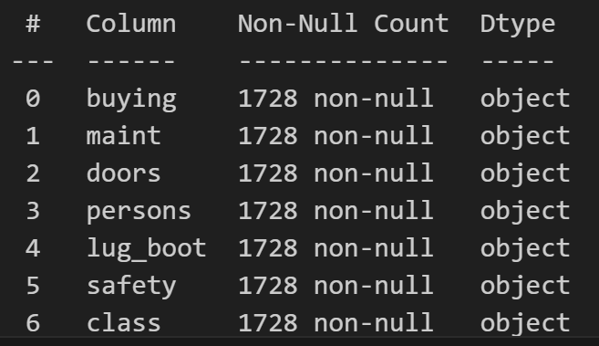
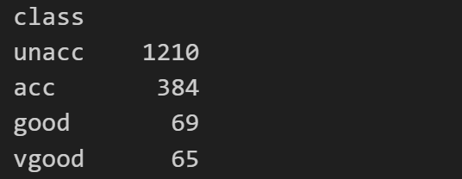
Characteristics

Slide 12
Hyperparameters
Max_depth:
Sets tree depth. If specified, limits how deep trees can grow. If not, trees grow until overfitting is detected or all nodes are pure.r
Min_samples_split:
Sets the minimum number of samples required to split a node. If specified, a node won't split if its samples are below this threshold. If not set, any node with at least one sample can potentially split. This parameter helps control the tree's growth and prevent overfitting.
Max_features:
Specifies the maximum number of features considered for splitting at each node. If set, limits the options for splitting. If not set, considers all features. Helps in controlling randomness and model complexity.
[None, 10, 20, 30]
[None, 10, 20, 30]
[1, 6, 'sqrt', 'log2', None]

Slide 13
Grid Search
Grid search finds the best model settings by testing different combinations of hyperparameters, like max_depth, max_features, and min_samples_split, systematically searching through a grid of possible values to find the most effective setup.
Grid Search result

Slide 14
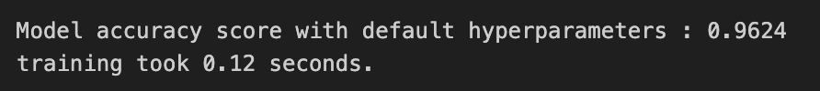
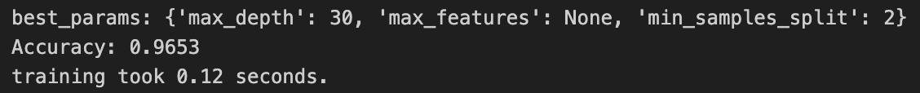
Model Training
Training the model with default parameters:
Training the model with custom parameters:

Slide 15
Feature impotance

Slide 16
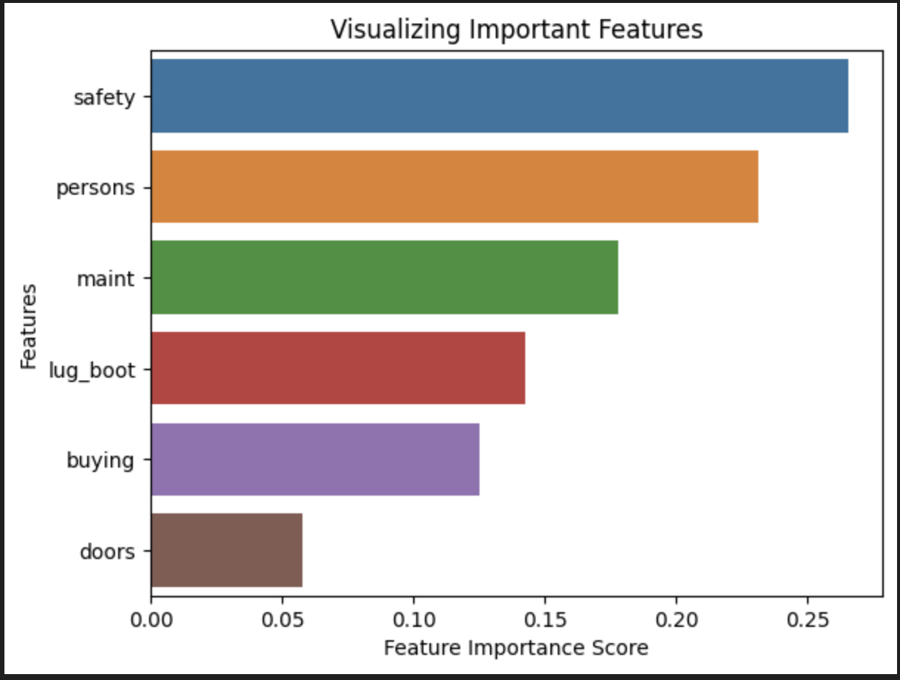
Model Understanding: Reveals which features are most influential in predicting outcomes, aiding in model interpretation.
Feature Selection: Guides the selection of relevant features, enhancing model performance and reducing complexity.
Explanatory Power: Facilitates transparent explanations of predictions by highlighting key contributing factors.

Slide 17

Final Results

Slide 18
Confusion matrix
A confusion matrix is a table that is often used to evaluate the performance of a classification model. It compares the actual values of the target variable with the values predicted by the model. Here's a brief overview:
True Positives (TP): The cases where the model correctly predicts the positive class.
True Negatives (TN): The cases where the model correctly predicts the negative class.
False Positives (FP): The cases where the model incorrectly predicts the positive class (Type I error).
False Negatives (FN): The cases where the model incorrectly predicts the negative class (Type II error).

Slide 19
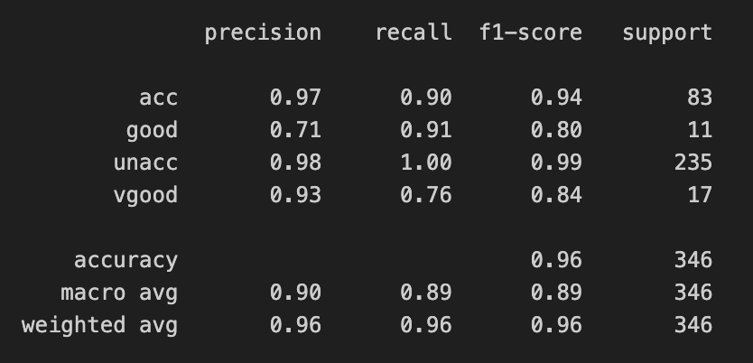
Final Results

Slide 20
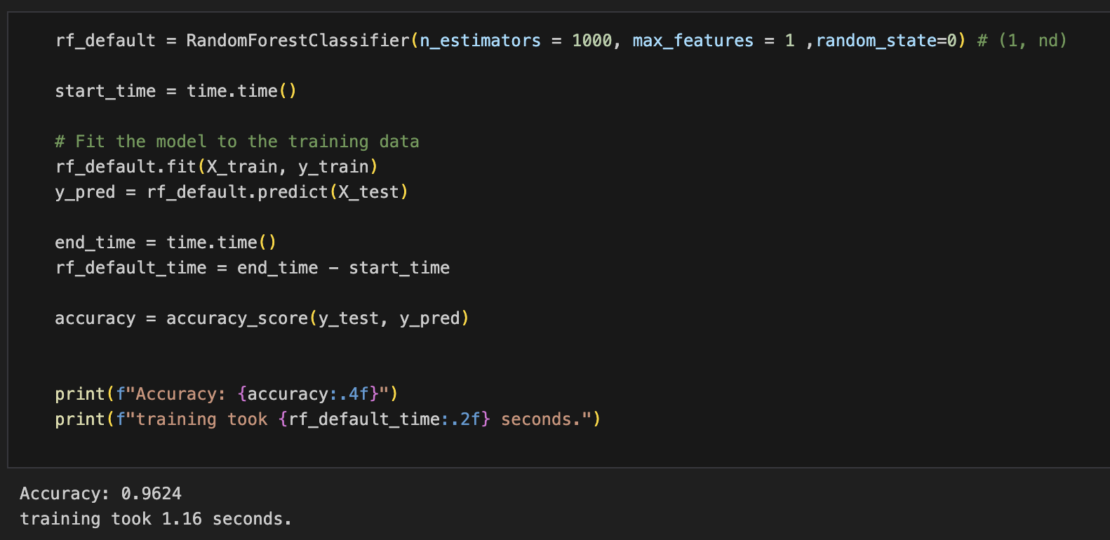
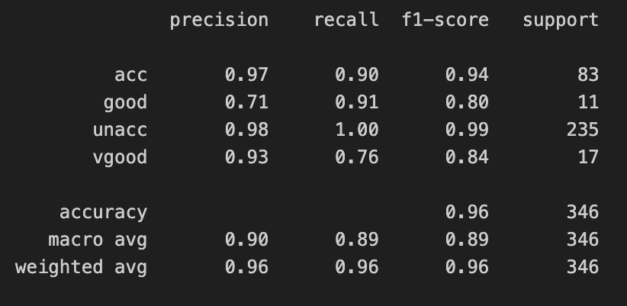
Final Results: Using custom hyperparamets

Slide 21

Over sampling the data using smoke

Slide 22
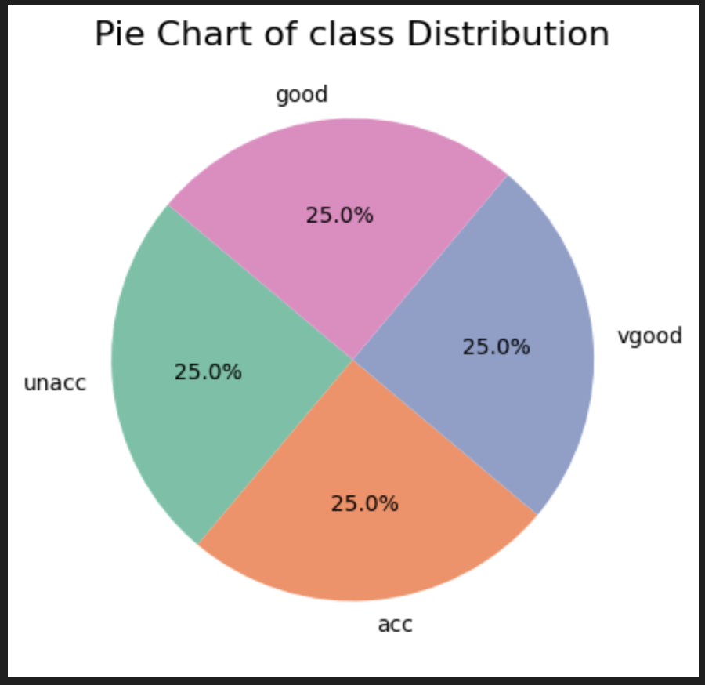
SMOTE
What is SMOTE: SMOTE is a technique used to balance imbalanced datasets by generating synthetic samples of the minority class, improving model performance in binary classification tasks.

Slide 23

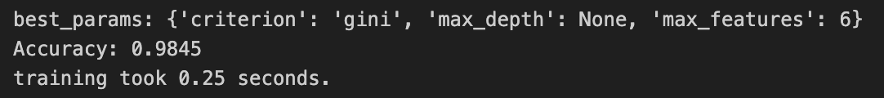
Over sampled data: Model Training
Training the model with default parameters:
Training the model with custom parameters:

Slide 24
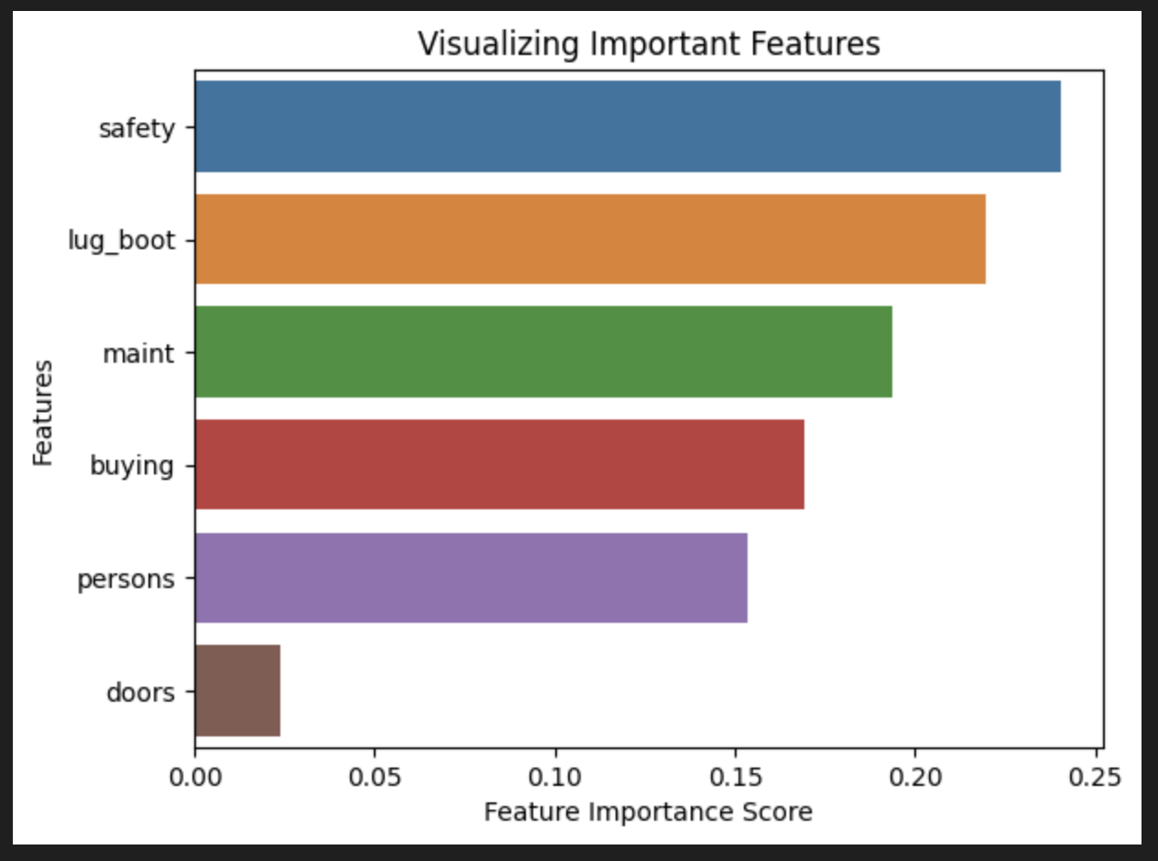
Over sampled data: Feature impotance

Slide 25
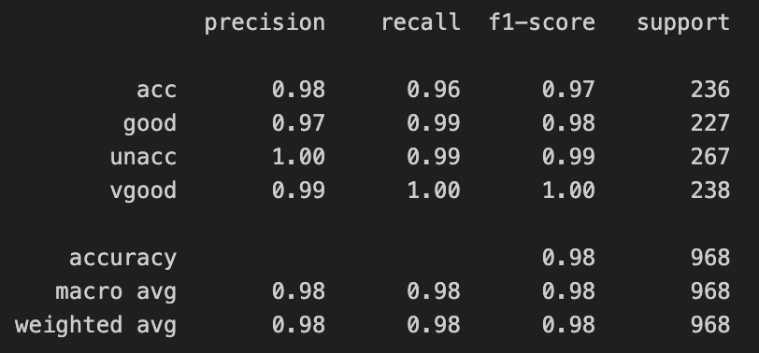
Over sampled data: Finall Results

Slide 26
Thank you

